Slide 1
Secure Data Hiding in Image Using Steganography
CAPSTONE PROJECT
Presented By: TEJASWI LAKSHMI PRIYA PILLALA
Student Name: TEJASWI LAKSHMI PRIYA PILLALA
College Name & Department : Pragati Engineering College, ECE

Slide 2
OUTLINE
Problem Statement
Technology used
Wow factor
End users
Result
Conclusion
Git-hub Link
Future scope

Slide 3
Problem Statement
With increasing cyber threats, secure data transmission is a challenge. Traditional encryption methods can be easily intercepted. This project utilizes steganography, embedding secret messages in images, making communication secure and undetectable.

Slide 4
Technology used
Programming Language: Python
Libraries: OpenCV, NumPy, OS
Concepts: Steganography, Image Processing, Cryptography

Slide 5
Wow factors
Uses steganography for hiding messages in images.Ensures secure communication with password protection.Works on any image format that OpenCV supports.Lightweight & Fast encryption and decryption process.

Slide 6
End users
Journalists & Whistleblowers: Securely transmit sensitive information.
Government & Military: Confidential communication.
Individuals & Businesses: Protect personal and business data.

Slide 7

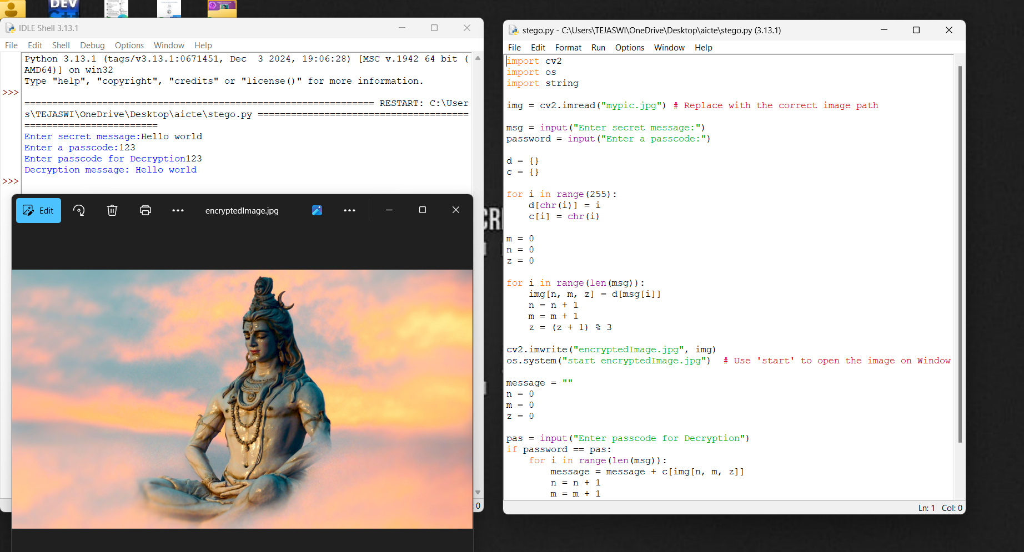
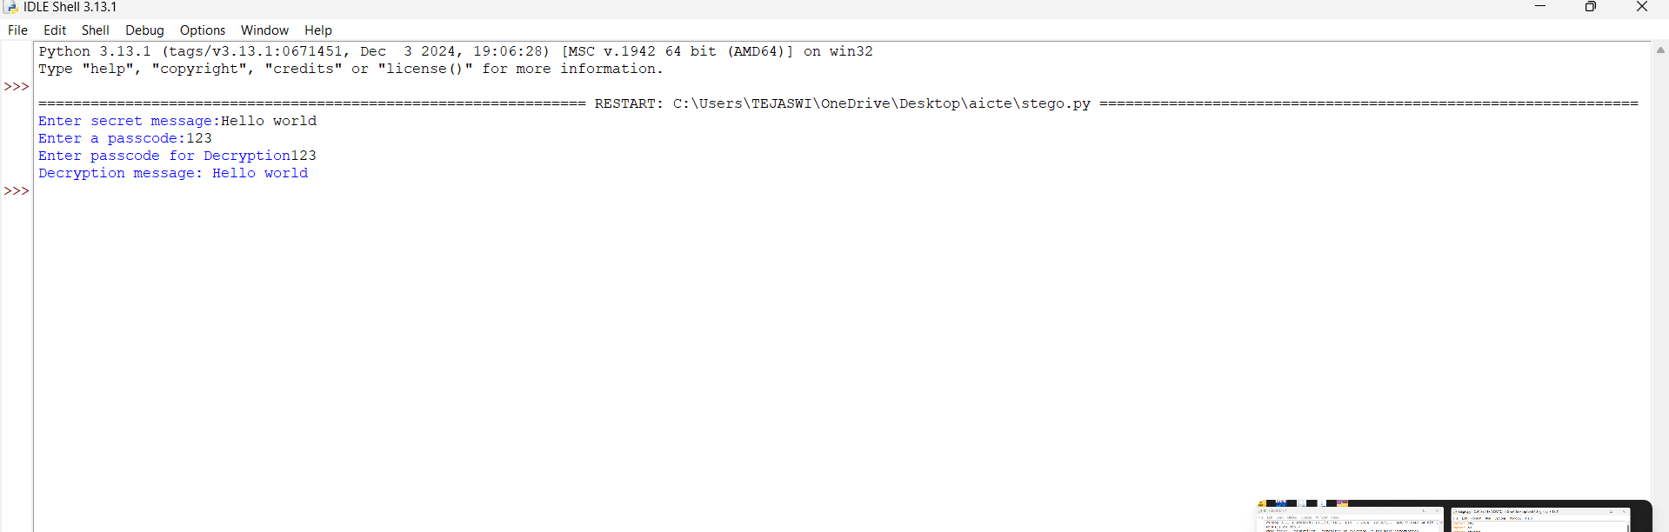
Results

Slide 8
Conclusion
This project successfully demonstrates a simple yet effective steganography technique for hiding and retrieving messages inside images. It provides an extra layer of security and can be further improved for real-world applications.

Slide 9
GitHub Link
https://github.com/Tejaswipriya1219/Secure-Data-Hiding-in-Image-Using-Steganography.git

Slide 10
Future scope(optional)
Enhance encryption with AES or RSA for extra security.
Develop a GUI application for non-programmers.
Support for video and audio steganography.
Implement AI-based detection resistance.

Slide 11
THANK YOU

